Slide 1

Foundation SCIENCE A
FSA Revision QUESTIONS AND Answers

Slide 2

Learning outcomes
Students are expected to understand the basic physics concepts and apply it to solve the following revision questions.

Slide 3
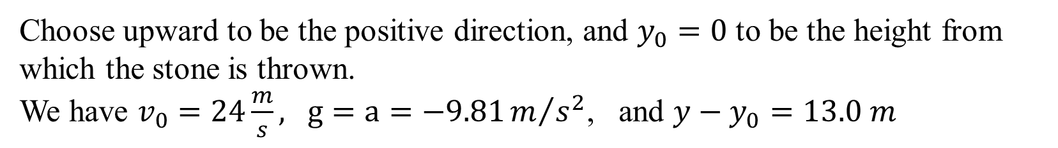
QUESTION 1:
A stone is thrown vertically upward with a speed of 24.0 m/s.
(i) How fast is it moving when it reaches a height of 13.0 m?
(ii) How much time is required to reach this height?
(iii) Why are there two answers to (ii)?
Answer:
Choose upward to be the positive direction, and $y_{0}=0$ to be the height from which the stone is thrown.
We have $v_{0}=24\frac{m}{s},$ $g=a=−9.81m/{s^{2}}$, and ${y−y}_{0}=13.0 m$

Slide 4
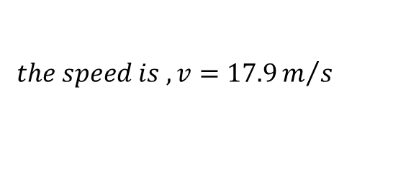
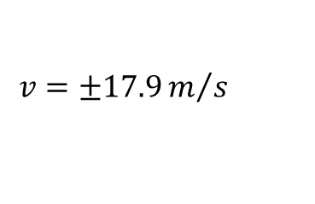
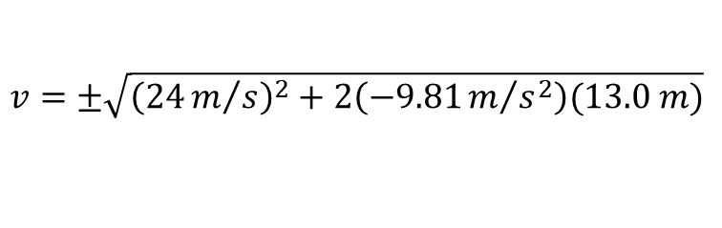


QUESTION 1:
Answer:
Choose upward to be the positive direction, and $y_{0}=0$ to be the height from which the stone is thrown. We have $v_{0}=24\frac{m}{s},$ $g=a=−9.81m/{s^{2}}$, and ${y−y}_{0}=13.0 m$
(i) How fast is it moving when it reaches a height of 13.0 m?
$$v^{2}={v_{0}}^{2}+2a(y−y_{0})$$
$$v=±\sqrt{{v_{0}}^{2}+2a(y−y_{0})}$$
$$v=±\sqrt{{\left(24m/s\right)}^{2}+2\left(−9.81m/{s^{2}}\right)(13.0 m)}$$
$$v=±17.9m/s$$
$$the speed is ,v=17.9m/s$$

Slide 5







QUESTION 1:
Answer:
Choose upward to be the positive direction, and $y_{0}=0$ to be the height from which the stone is thrown. We have $v_{0}=24\frac{m}{s},$ $g=a=−9.81m/{s^{2}}$, and ${y−y}_{0}=13.0 m$
(ii) How much time is required to reach this height?
$$y−y_{o}=v_{o}t+\frac{1}{2}at^{2}$$
$$t=\frac{\left(−b\right)±\sqrt{b^{2}−4ac}}{2a}$$
$$13=24t+\frac{1}{2}\left(−9.81\right)t^{2}$$
$$t=4.28 s and 0.620 s$$
$$26=48t+\left(−9.81\right)t^{2}$$
$$\left(9.81\right)t^{2}−48t+26=0$$
$$t^{2}−4.89t+2.65=0$$

Slide 6


QUESTION 1:
Answer:
Choose upward to be the positive direction, and $y_{0}=0$ to be the height from which the stone is thrown. We have $v_{0}=24\frac{m}{s},$ $g=a=−9.81m/{s^{2}}$, and ${y−y}_{0}=13.0 m$
(iii) Why are there two answers to (ii)?
$$t=\frac{\left(−b\right)±\sqrt{b^{2}−4ac}}{2a}$$
$$t=4.28 s and 0.620 s$$
There are two times at which the object reaches that height – once on the way up (t = 0.620 s), and once on the way down (t = 4.28 s).

Slide 7


QUESTION 2:
A 20.0 kg box rests on a table, as shown in the figure below.
(i) What is the weight of the box and the normal force acting on it?
(ii) A 10.0 kg box is placed on top of the 20.0 kg box, also shown in the figure below. Determine the normal force that the table exerts on the 20.0 kg box and the normal force that the 20.0 kg box exerts on the 10.0 kg box.
$$F_{N}$$
Answer:
20kg
$$m_{1}g$$

Slide 8
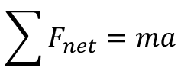
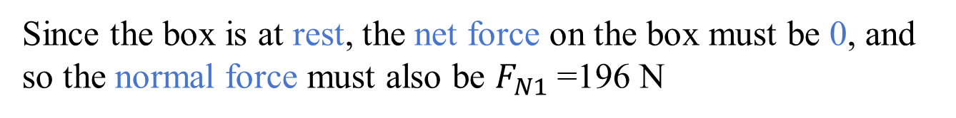
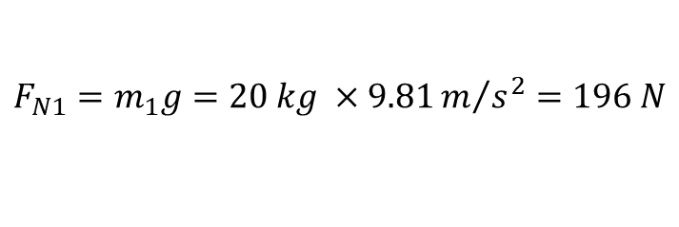


QUESTION 2:
A 20.0 kg box rests on a table, as shown in the figure below.
(i) What is the weight of the box and the normal force acting on it?
Answer:
The 20.0 kg box resting on the table has the free-body diagram shown.
$$\sum{F_{net}=ma}$$
$${F_{N1}=m}_{1}g=20 kg ×9.81m/{s^{2}=196 N}$$
$$F_{N1}$$
Since the box is at rest, the net force on the box must be 0, and so the normal force must also be $F_{N1}$=196 N
20kg
$$m_{1}g$$

Slide 9
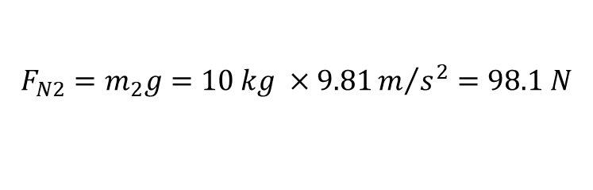


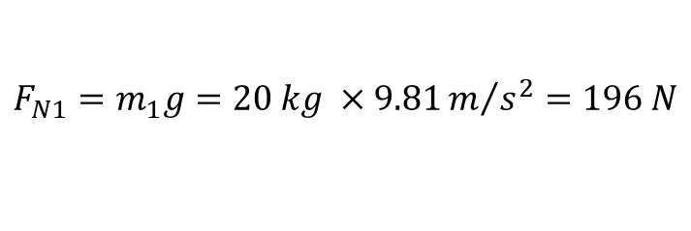
QUESTION 2:
A 20.0 kg box rests on a table, as shown in the figure below.
(ii) A 10.0 kg box is placed on top of the 20.0 kg box, also shown in the figure below. Determine the normal force that the table exerts on the 20.0 kg box and the normal force that the 20.0 kg box exerts on the 10.0 kg box.
$$F_{N2}$$
$${F_{N2}=m}_{2}g=10 kg ×9.81m/{s^{2}=98.1 N}$$
Answer:
$${F_{N1}=m}_{1}g=20 kg ×9.81m/{s^{2}=196 N}$$
$$F_{N1}$$
$$F_{N}={F_{N1}+F}_{N2}=98.1 N+196N=294.1N$$
$$m_{2}g$$
20kg
$$m_{1}g$$

Slide 10
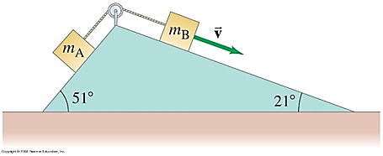
QUESTION 3:
Two masses mA = 2.0 kg and mB = 5.0 kg are on inclines and are connected together by a string as shown in the figure below. The coefficient of kinetic friction between each mass and its incline is μk = 0.30. If mA moves up, and mB moves down, determine their acceleration.

Slide 11
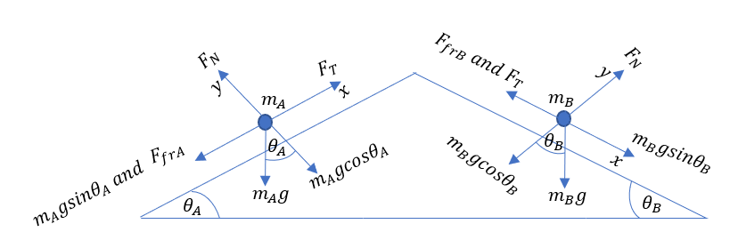
Answer:

Slide 12
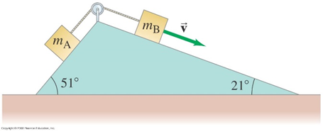
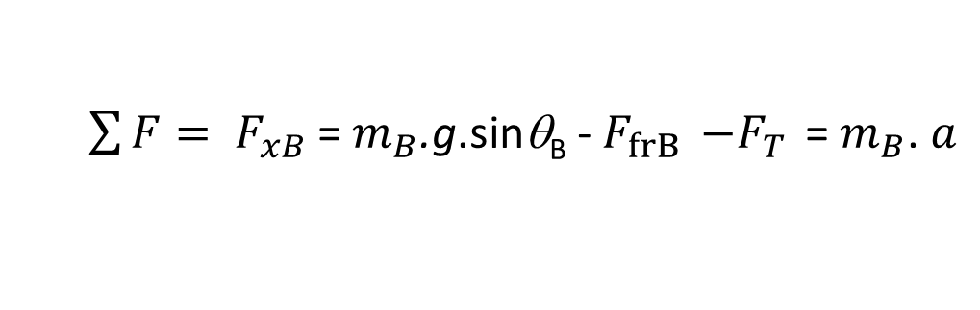
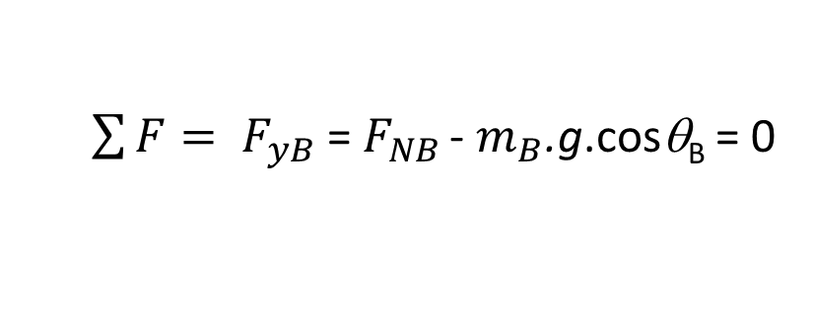
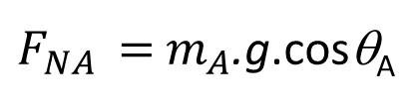
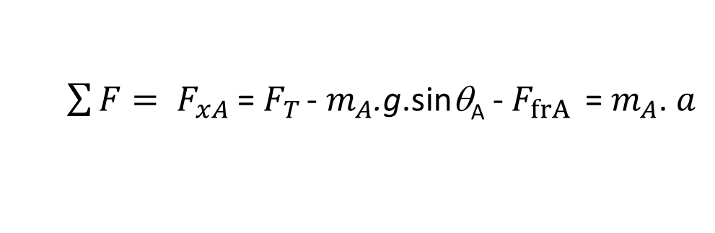
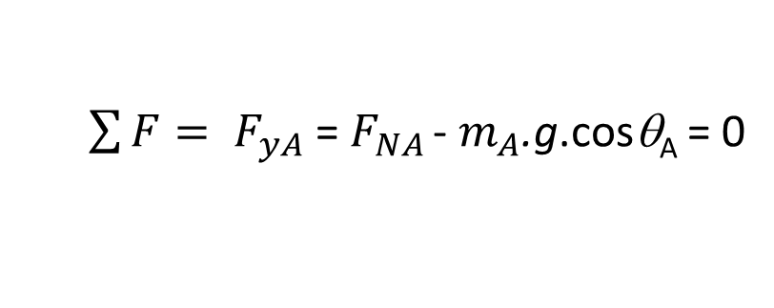
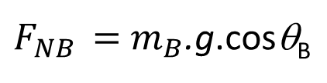
Answer:
Block A:
$\sum{F= F_{yA}}$ = $F_{NA }$- $m_{A}$.g.cosθ_{A} = 0
$F_{NA }=$ $m_{A}$.g.cosθ_{A}
$\sum{F= F_{xA}}$ = $F_{T }$- $m_{A}$.g.sinθ_{A} - $F_{frA }$ = $m_{A}$. $a$
Block B:
$\sum{F= F_{yB}}$ = $F_{NB }$- $m_{B}$.g.cosθ_{B} = 0
$F_{NB }=$ $m_{B}$.g.cosθ_{B}
$\sum{F= F_{xB}}$ = $m_{B}$.g.sinθ_{B} - $F_{frB }$ ${−F}_{T }$= $m_{B}$. $a$

Slide 13
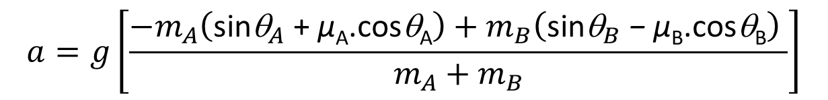
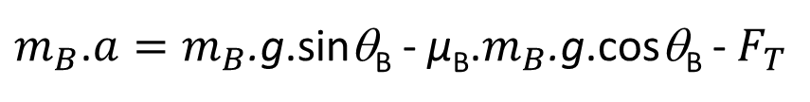
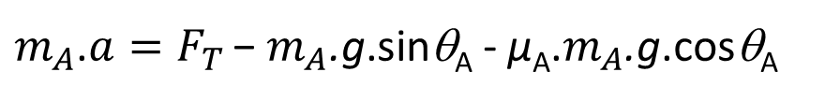
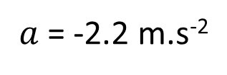
Add the final equations together from both analyses and solve for the acceleration, noting that in both cases the friction force is found as $F_{fr}= μF_{N}.$
$m_{A}$.$a=F_{T }\text{− }m_{A}\text{.}\text{g}\text{.}\text{sin}\text{θ}\text{A}$ - µ_{A}.$m_{A}$.g.cosθ_{A}
$m_{B}$.$a=m_{B}\text{.}\text{g}\text{.}\text{sin}\text{θ}\text{B}$ - µ_{B}.$m_{B}$.g.cosθ_{B} - $F_{T }$
$m_{A}$.$a+m_{B}\text{.}a$ = $F_{T }\text{− }m_{A}\text{.}\text{g}\text{.}\text{sin}\text{θ}\text{A}$ - µ_{A}.$m_{A}$.g.cosθ_{A} + $m_{B}\text{.}\text{g}\text{.}\text{sin}\text{θ}\text{B}$ - µ_{B}.$m_{B}$.g.cosθ_{B} - $F_{T }$
$$a=g\left[\frac{−m_{A}\left(\text{sin}{\text{θ}}_{A}\text{ +} \text{µ}\text{A}\text{.} \text{cos}\text{θ}\text{A}\right)+m_{B}\left(\text{sin}{\text{θ}}_{B} \text{− }\text{µ}\text{B}\text{.} \text{cos}\text{θ}\text{B}\right) }{m_{A}+m_{B}}\right]$$
= 9.81 m.s⁻²$\left[\frac{−2kg\left(\text{sin}\text{51}°\text{ +} \text{0.3}\text{.} \text{cos}\text{51}°\right)+5kg\left(\text{sin}\text{21}°\text{−}\text{0.3}\text{.} \text{cos}\text{21}°\right) }{m_{A}+m_{B}}\right]$
$a$= -2.2 m.s⁻²

Slide 14
QUESTION 4:
The graph of displacement vs. time for a small mass m at the end of a spring is shown in the figure below. At t = 0, x = 0.43 cm.
(i) If m = 9.5 g, find the spring constant, k.
Answer:
From the graph, the period is 0.69 s. The period and the mass can be used to find the spring constant.
$$T=2π\sqrt{\frac{m}{k}} →k=4π^{2}\frac{m}{T^{2}}=4π^{2}\frac{0.0095kg}{{\left(0.69 s\right)}^{2}}=0.7877N/m$$

Slide 15

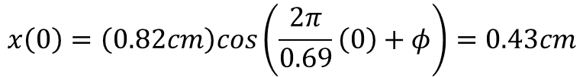
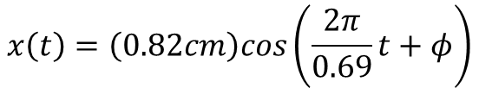
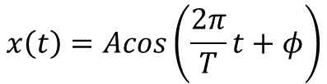

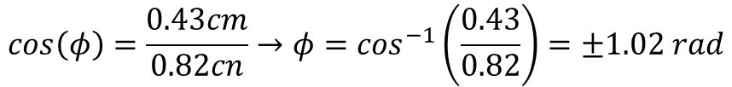
QUESTION 4:
The graph of displacement vs. time for a small mass m at the end of a spring is shown in the figure below. At t = 0, x = 0.43 cm.
(ii) Write the equation for displacement x as a function of time.
From the graph, the amplitude is 0.82 cm. The phase constant can be found from the initial conditions.
At t = 0
$$x\left(t\right)=Acos\left(ωt+φ\right)$$
$$x\left(0\right)=\left(0.82cm\right)cos\left(\frac{2π}{0.69}\left(0\right)+φ\right)=0.43cm$$
$$x\left(t\right)=Acos\left(\frac{2π}{T}t+φ\right)$$
$$x\left(0\right)=\left(0.82cm\right)cos\left(φ\right)=0.43cm$$
$$x\left(t\right)=\left(0.82cm\right)cos\left(\frac{2π}{0.69}t+φ\right)$$
$$cos\left(φ\right)=\frac{0.43cm}{0.82cn}→φ=\cos^{−1}\left(\frac{0.43}{0.82}\right)=±1.02 rad$$

Slide 16
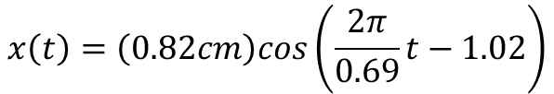
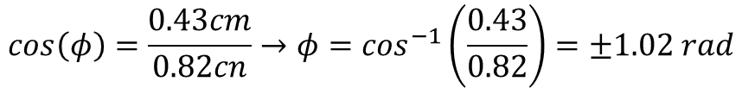
QUESTION 4:
The graph of displacement vs. time for a small mass m at the end of a spring is shown in the figure below. At t = 0, x = 0.43 cm.
(ii) Write the equation for displacement x as a function of time.
$$cos\left(φ\right)=\frac{0.43cm}{0.82cn}→φ=\cos^{−1}\left(\frac{0.43}{0.82}\right)=±1.02 rad$$
Because the graph is shifted to the RIGHT from the 0-phase cosine, the phase constant must be subtracted.
$$x\left(t\right)=\left(0.82cm\right)cos\left(\frac{2π}{0.69}t−1.02\right)$$

Slide 17

QUESTION 5:
Particles of charge +75, +48, and -85 μC are placed in a line as shown in the figure below. The centre one is 0.35 m from each of the others. Calculate the net force on each charge due to the other two.
Answer:
Let the right be the positive direction on the line of charges. Use the fact that like charges repel and unlike charges attract to determine the direction of the forces. In the following expressions

Slide 18
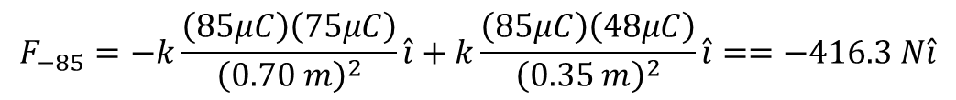
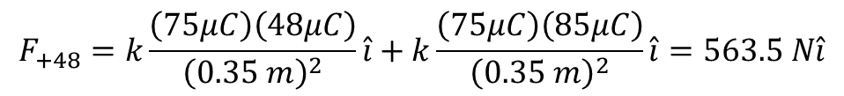
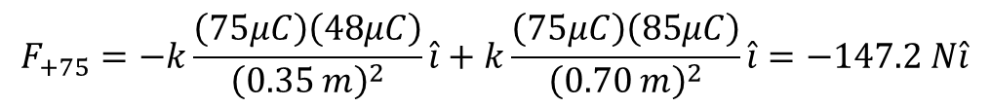

QUESTION 5:
Particles of charge +75, +48, and -85 μC are placed in a line as shown in the figure below. The centre one is 0.35 m from each of the others. Calculate the net force on each charge due to the other two.
Answer:
$$F=k\frac{Q_{1}Q_{2}}{r^{2}}, where k=8.988×{10}^{9}{Nm^{2}}/{C^{2}}$$
$$F_{+75}=−k\frac{\left(75μC\right)\left(48μC\right)}{{\left(0.35 m\right)}^{2}}\hat{i}+k\frac{\left(75μC\right)\left(85μC\right)}{{\left(0.70 m\right)}^{2}}\hat{i}=−147.2 N\hat{i}$$
$$F_{+48}=k\frac{\left(75μC\right)\left(48μC\right)}{{\left(0.35 m\right)}^{2}}\hat{i}+k\frac{\left(75μC\right)\left(85μC\right)}{{\left(0.35 m\right)}^{2}}\hat{i}=563.5 N\hat{i}$$
$$F_{−85}=−k\frac{\left(85μC\right)\left(75μC\right)}{{\left(0.70 m\right)}^{2}}\hat{i}+k\frac{\left(85μC\right)\left(48μC\right)}{{\left(0.35 m\right)}^{2}}\hat{i}==−416.3 N\hat{i}$$

Slide 19

QUESTION 6:
A 32 cm diameter conducting sphere is charged to 680 V relative to V = 0 at r =∞.
(i) What is the surface charge density ?
(ii) At what distance will the potential due to the sphere be only 25 V?
Answer:
(i) The potential at the surface of a charged sphere is
$$V=\frac{Q}{4πε_{0}r}→Q=V4πε_{0}r$$
$$σ=\frac{Q}{A}=\frac{V4πε_{0}r}{4πr^{2}}=\frac{Vε_{0}}{r}=\frac{\left(680V\right)\left(8.85×{10}^{−12}{C^{2}}/{Nm^{2}}\right)}{\left(0.16 m\right)}=3.761×{10}^{−8}c/m^{2}$$

Slide 20



QUESTION 6:
A 32 cm diameter conducting sphere is charged to 680 V relative to V = 0 at r =∞.
(i) What is the surface charge density ?
(ii) At what distance will the potential due to the sphere be only 25 V?
Answer:
(ii) The potential away from the surface of a charged sphere is
$$V_{a}=\frac{Q}{4πε_{0}r_{a}}$$
$$but Q=V4πε_{0}r$$
$$V_{a}=\frac{V4πε_{0}r}{4πε_{0}r_{a}} →r_{a}=\frac{Vr}{V_{a}}=\frac{\left(0.16 m\right)\left(680 V\right)}{\left(25 V\right)}=4.342 m$$

Slide 21
QUESTION 7:
How much energy must a 28 V battery expend to charge a 0.45 μF and a 0.20 μF capacitor fully when they are placed
(i) in parallel; and
(ii) in series?
(iii) How much charge flows from the battery in each case?
Answer:
(i) Using the equations below
$$U_{parallel}=\frac{1}{2}C_{eq}V^{2}=\frac{1}{2}\left(C_{1}+C_{2}\right)V^{2}=\frac{1}{2}\left(0.65×{10}^{−6}F\right){\left(28\right)}^{2}=2.548×{10}^{−4}J$$

Slide 22
QUESTION 7:
How much energy must a 28 V battery expend to charge a 0.45 μF and a 0.20 μF capacitor fully when they are placed
(i) in parallel; and
(ii) in series?
(iii) How much charge flows from the battery in each case?
Answer:
(ii) Using the equations below
$$U_{parallel}=\frac{1}{2}C_{eq}V^{2}=\frac{1}{2}\left(\frac{C_{1}C_{2}}{C_{1}+C_{2}}\right)V^{2}=\frac{1}{2}\left(\frac{\left(0.45×{10}^{−6}F\right)\left(0.20×{10}^{−6}F\right)}{\left(0.65×{10}^{−6}F\right)}\right){\left(28\right)}^{2}=5.428×{10}^{−5}J$$

Slide 23

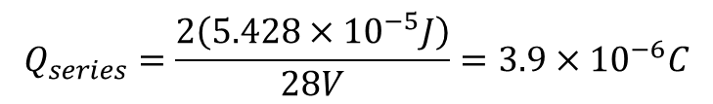
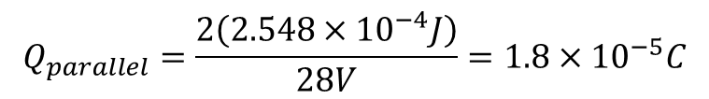
QUESTION 7:
How much energy must a 28 V battery expend to charge a 0.45 μF and a 0.20 μF capacitor fully when they are placed
(i) in parallel; and
(ii) in series?
(iii) How much charge flows from the battery in each case?
Answer:
(iii) Using the equations below
$$U=\frac{1}{2}QV→Q=\frac{2U}{V}$$
$$Q_{parallel}=\frac{2\left(2.548×{10}^{−4}J\right)}{28V}=1.8×{10}^{−5}C$$
$$Q_{series}=\frac{2\left(5.428×{10}^{−5}J\right)}{28V}=3.9×{10}^{−6}C$$

Slide 24
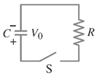
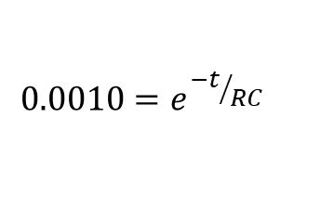
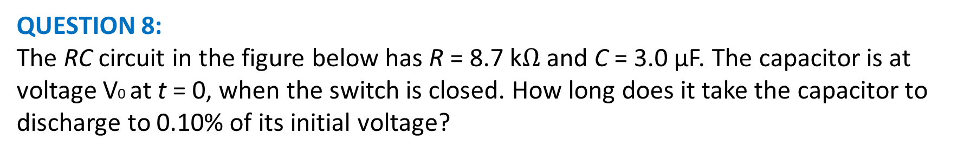
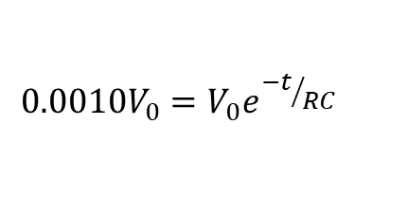

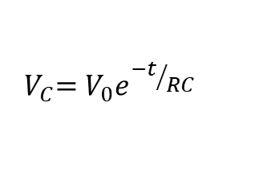
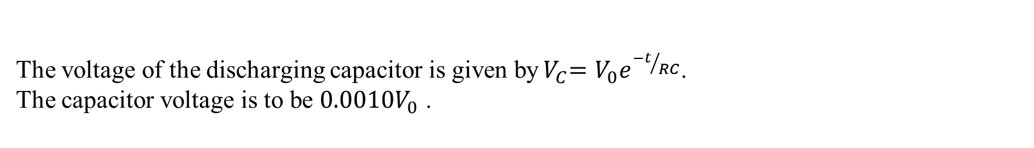

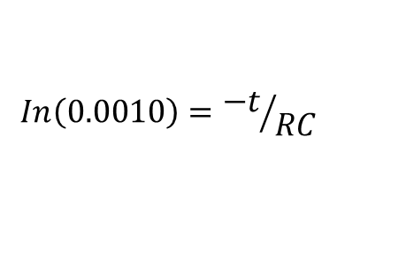
QUESTION 8:
The RC circuit in the figure below has R = 8.7 k$Ω$ and C = 3.0 μF. The capacitor is at voltage V0 at t = 0, when the switch is closed. How long does it take the capacitor to discharge to 0.10% of its initial voltage?
Answer:
The voltage of the discharging capacitor is given by${ V}_{C}=V_{0}e^{{−t}/{RC}}$.
The capacitor voltage is to be ${0.0010V}_{0}$ .
$${ V}_{C}=V_{0}e^{{−t}/{RC}}$$
$$In\left(0.0010\right)={−t}/{RC}$$
$${0.0010V}_{0}=V_{0}e^{{−t}/{RC}}$$
$$t=−RCIn\left(0.0010\right)$$
$$0.0010=e^{{−t}/{RC}}$$
$$t=−\left(8.7{×10}^{3}Ω\right)\left(3.0{×10}^{−6}F\right)In\left(0.0010\right)$$
$$t=0.18 s$$

Slide 25
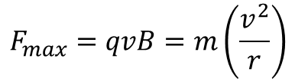
QUESTION 9:
An electron is projected vertically upward with a speed of 1.70 × 10⁶ m/s into a uniform magnetic field of 0.480 T that is directed horizontally away from the observer. What is the radius of motion? The mass of an electron is 9.11 × 10⁻³¹kg, and the charge on an electron is 1.66 × 10⁻¹⁹ C.
Answer:
$$F_{max}=qvB=m\left(\frac{v^{2}}{r}\right)$$
$$r=\frac{mv^{2}}{qB}=\frac{\left(9.11×{10}^{−31}kg\right){\left(1.70×{10}^{6}m/s\right)}^{2}}{\left(1.60×{10}^{−19}C\right)\left(0.480T\right)}=2.o2×{10}^{−5}m$$

Slide 26
Q&A? Office hours:

